Slide 1
GUVI Capstone Project
Walmart Superstore Sales Analysis
MBT7
By
G. Arivazhagan

Slide 2

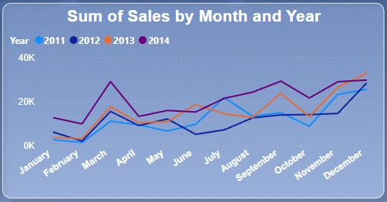
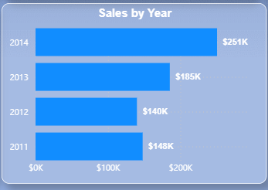
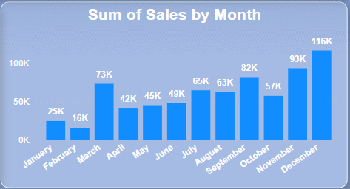
Sales Analysis
In an Over all view we can see the months March, September, November and December we are having an good improvements in sales
In sales by Year Chart we can see we have Approximately 65.59% increase in sales from 2011 to 2014

Slide 3
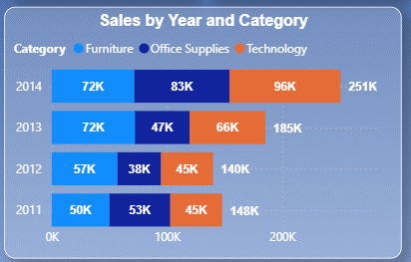
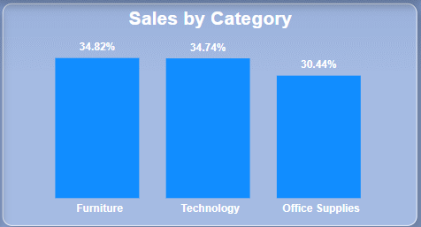
Sales Analysis
In an Over all of Sales by Category view we can see the Furniture is contributing 34.82% of the sales and in 2nd place is technology with 34.74% and in 3rd place we have Office supplies.
From the Sales by year and category chart we can see the break down of category by year
We can see a significant Growth of Technology in 2013 and 2014 where there is no significant difference in Furniture.

Slide 4
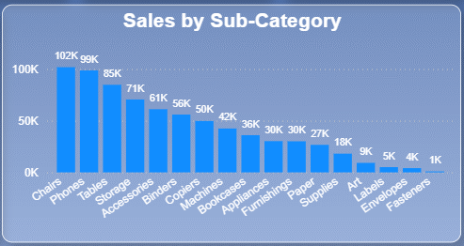
Sales Analysis
Here we can see How each Sub Category is working
From Sales By Sub-Category we can see Chairs Are the top performing Sub-Category
Where Fasteners are the low Performing once.
We will see more details on Sub-Category in Pareto Analysis

Slide 5
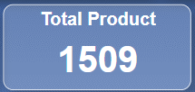
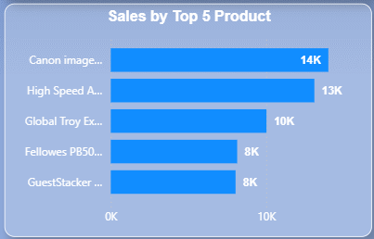
Sales Analysis
Here are our top 5 products by sales from 1509 Products.
Canon image CLASS 2200 Advanced Copier
High Speed Automatic Electric Letter Opener
Global Troy Executive Leather Low-Back Tilter
Fellowes PB500 Electric Punch Plastic Comb Binding Machine with Manual Bind
Guest Stacker Chair with Chrome Finish Legs

Slide 6
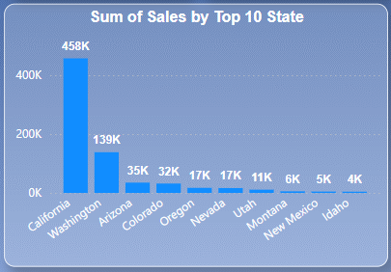
Sales Analysis
In the chart mentioned above, we can observe the top 10 states that are performing well in sales.
Here We can see we are making a good sales in Claifornia.
We will see more details on State in Pareto Analysis

Slide 7
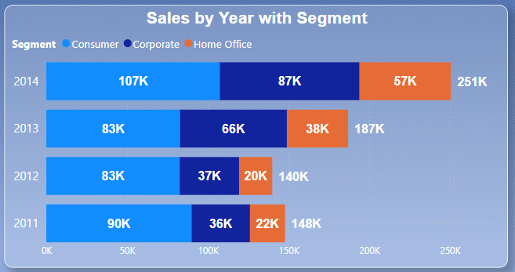
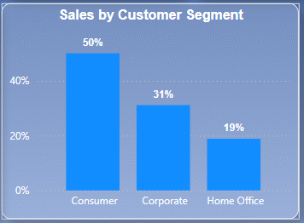
Sales Analysis
Here, we divide our customers into three segments:
Consumer
Corporate
Home Office
Out of these three, consumers contribute around 50% of the sales, followed by Corporate.
When comparing data between 2011 and 2014 (just an observation):
Consumers increased by 18.89%.
Corporate increased by 141.67%.
Home Office increased by 128.0%.

Slide 8
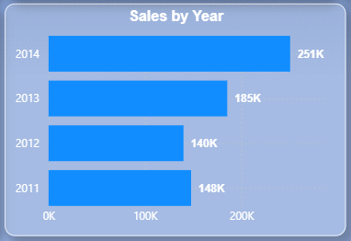
Sales Analysis
In an Over all view we can see the months March, September, November and December we are having an good improvements in sales
In sales by Year Chart we can see we have Approximately 65.59% increase in sales from 2011 to 2014

Slide 9
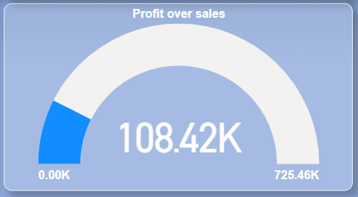
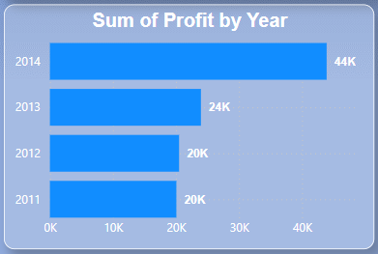
Profit Analysis
Here in Profit Over sales we can see we Made Around 725.46K in total sales and made 108.42K in Profit
I short we made approximately 4.02% more Profit from 2014 compared to 2011
Profit percentages for each year ((Sales/profit) X100)
2011 - 13.51%
2012 – 14.29%
2013 - 12.97%
2014 – 17.53%
which show 2014 is the highest among the most Profitable Year compared from 2011
Total sales
Profit

Slide 10
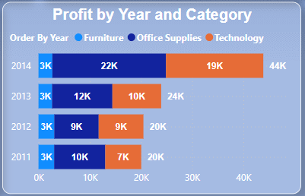
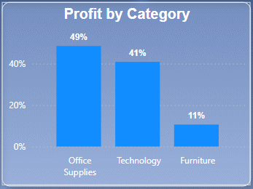
Profit Analysis
Here we can see the Profit by each Category.
From Profit and category chart we can see 49% of the total profit is from Office supplies and 41% from Technology and the rest from furniture.
If we take a closer look into Profit by Year and category Chart we can notice there is a huge growth from 2013 to 2014 which
90% in Technology.
83.33% in Office Supplies.
And it is important to notice that there is no difference in furniture Category profit even though we are getting 34.82% sales.

Slide 11
Profit Analysis
Here we can see the Profit by each Category.
From Profit and category chart we can see 49% of the total profit is from Office supplies and 41% from Technology and the rest from furniture.
If we take a closer look into Profit by Year and category Chart we can notice there is a huge growth from 2013 to 2014 which
90% in Technology.
83.33% in Office Supplies.
And it is important to notice that there is no difference in furniture Category profit even though we are getting 34.82% sales.

Slide 12
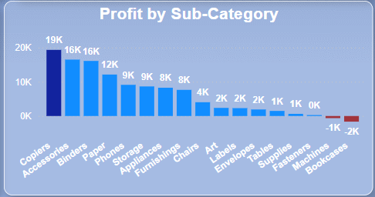
Profit Analysis
The chart you can see above is showing the Profit made by Each sub category.
We can see Two Sub-category are going in negative value which is clearly indicating profit loss.
We made a sale of 36K in Bookcases but made a -2K in loss as a result, and 42K sales but we made -1K in Machines Sub-Category.
Which shows strong red Signal that indicates something wrong.

Slide 13
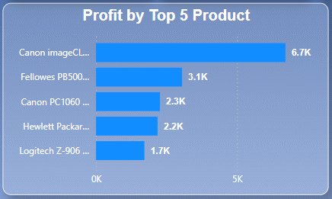
Profit Analysis
Here are our top 5 products by Profit from 1509 Products.
Canon image CLASS 2200 Advanced Copier
Fellowes PB500 Electric Punch Plastic Comb Binding Machine with Manual Bind
Canon PC1060 Personal Laser Copier
Hewlett Packard LaserJet 3310 Copier
Logitech Z-906 Speaker sys - home theater - 5.1-CH
Here we can see “Canon image CLASS 2200 Advanced Copier” is contributing approximately 6.18% to the over all profit.

Slide 14
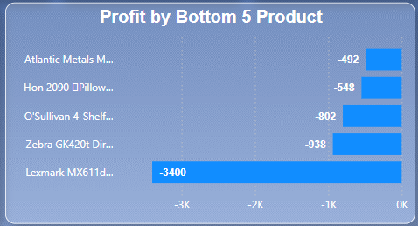
Profit Analysis
Here are our 5 low Performing products by Profit from 1509 Products. With sub category
Lexmark MX611dhe Monochrome Laser Printer (Machines)
Zebra GK420t Direct Thermal/Thermal Transfer Printer (Machines)
O'Sullivan 4-Shelf Bookcase in Odessa Pine (Bookcases)
Hon 2090 Pillow Soft Series Mid Back Swivel/Tilt Chairs (Chairs)
Atlantic Metals Mobile 4-Shelf Bookcases, Custom Colors(Bookcases)
Here in these 5 products we can see we are seeing loss which is an clear Red signal for our business. That these products need out attention.

Slide 15
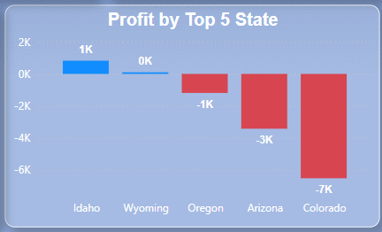
Profit Analysis
Here are our 5 low Performing state by Profit
Here is an detailed data
Idaho - 4K in sales and 1k in profit (25%)
Wyoming – 1.6k in sales and 100.2 in Profit (6.26%)
Oregon – 17K in sales and -1K in loss (-5.88%)
Arizona – 35K in sales and -3K in loss (-8.57%)
Colorado – 32K in sales and -7K in loss (-21.88%)
Here in Oregon, Arizona, Colorado we can see we are seeing loss which is an clear Red signal for our business, That these states need our attention.

Slide 16
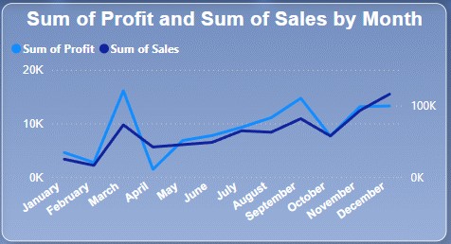
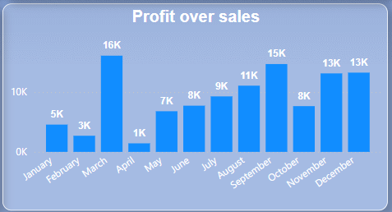
Profit Analysis
In an Over all view we can see the months March and September are the most Profitable.
Here is an small break down.
March – 25K in sales and 16K in Profit (64%)
September – 82K in sales and 15K in profit (18.29%)
On the down side we have the month April
We made a sales of Rs.42K and made only 1K (2.38%) in profit.

Slide 17
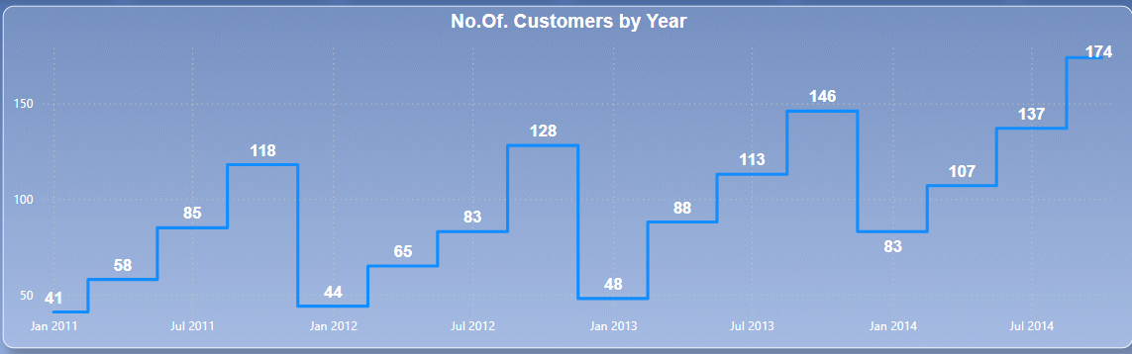
Customers
During Q4, we experience a significant increase in new customers every year.
Conversely, Q1 is the quarter where we receive the fewest new customers each year.
The chart clearly explains that the customer base keeps growing steadily compared to the previous year.

Slide 18
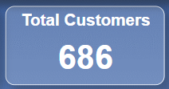
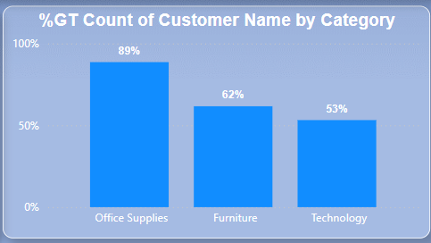
Customers Analysis
Here we can see that 89% of our customers are from the Office Supplies category, followed by Furniture and Technology.
If you take a closer look, you'll notice that the percentages in the chart don’t add up. This is because one customer might have purchased items across multiple categories.
It is good to see the customer basket value Spread across different categories, which is a healthy signal for our business.

Slide 19
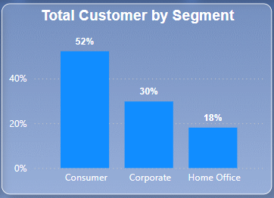
Customers Analysis
We can see 52 % of our Customer’s are from Consumers segment followed by Corporate 30% and Home Office 18%
By focusing on the specific needs and preferences of each customer segment, we can drive more conversions and improve overall sales.

Slide 20
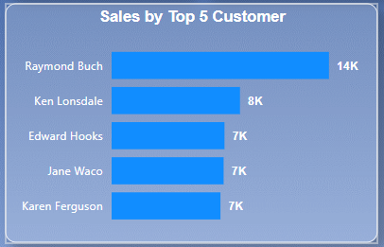
Customers Analysis
Here we have the Top 5 Customers based on sales
We can contact these customers to ask about their shopping experience and identify areas for improvement or new Products they might be looking for to enhance their experience.
It is recommended to offer a coupon if the customer provides feedback.
While the top 5 customers may not be a large enough sample, their insights can help us estimate how many additional surveys we need to conduct to gather more comprehensive feedback.

Slide 21
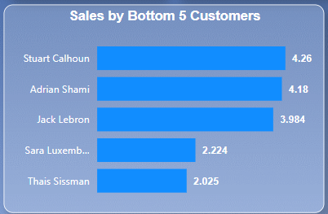
Customers Analysis
Here we have the Bottom 5 Customers based on sales
We can contact these customers to ask about their shopping experience and identify areas for improvement or new Products they might be looking for to enhance their experience.
It is recommended to offer a coupon if the customer provides feedback.
While the top 5 customers may not be a large enough sample, their insights can help us estimate how many additional surveys we need to conduct to gather more comprehensive feedback.
Here there is an high chance of finding out Problems which need fixing

Slide 22
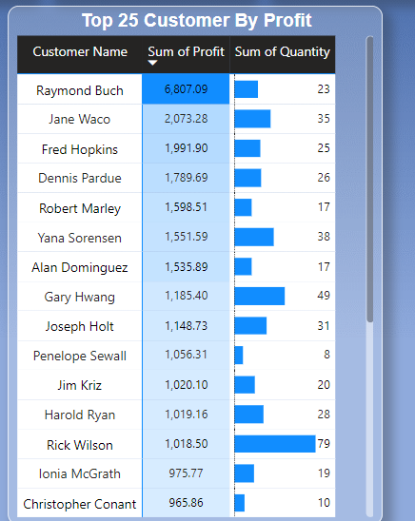
Customers Analysis
Here we have the Top 25 Customers based on Profit
We can contact these customers to ask about their shopping experience and identify areas for improvement or new Products they might be looking for to enhance their experience.
It is recommended to offer a coupon if the customer provides feedback.
While the top 25 customers may not be a large enough sample, their insights can help us estimate how many additional surveys we need to conduct to gather more comprehensive feedback.
Since the customers bought multiple quantity we have an high change of finding a pattern in bulk orders based on customer experience and feed backs

Slide 23
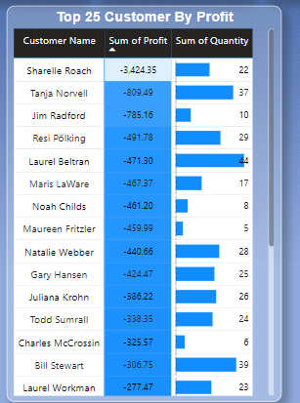
Customers Analysis
Here we have the Bottom 25 Customers based on Profit
We can contact these customers to ask about their shopping experience and identify areas for improvement or new Products they might be looking for to enhance their experience.
It is recommended to offer a coupon if the customer provides feedback.
While the top 25 customers may not be a large enough sample, their insights can help us estimate how many additional surveys we need to conduct to gather more comprehensive feedback.
Since the customers bought multiple quantity we have an high change of finding the issues that made the order going into loss instated of profit.

Slide 24
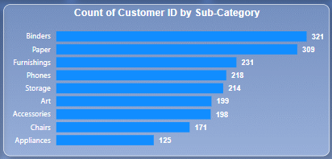
Customers Analysis
We can see Binders Sub-Category has the top Audience base with 321 customers.
Here are also we can see the customer count does’t add up because the customs would like to purchase across multiple sub-category.
This trend indicate a green signal for our store which is an healthy growth.

Slide 25
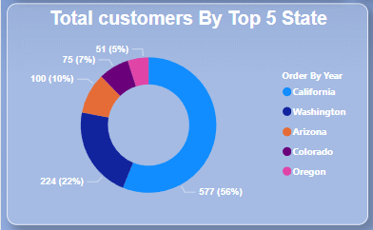
Customers Analysis
Since California is the highest contributor in sales, it is no surprise to see a high customer count there.
The surprising part is that customers are buying across states while traveling.
We can use this insight to build a loyal customer base by providing additional benefits to travelers.
Consider offering a small discount of 5% (if the profit margin permits) on products that support travelers, like water bottles, snacks, juices, etc.
Arrange these products near the entrance to make them easy for travelers to locate and purchase.

Slide 26
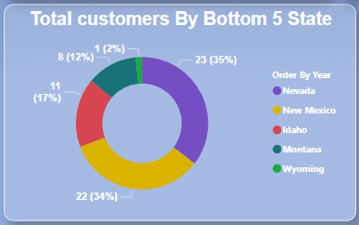
Customers Analysis
Since we have too low of a customer base in these states, it is recommended to collect feedback from all customers to identify the issues.
Conducting a local survey with the public could improve our chances of understanding what locals prefer in our store.
Announce a flash sale (if the profit margin permits) to attract new customers.
Provide a small coupon of 5% (if the profit margin permits) to each customer who buys during the flash sale.

Slide 27
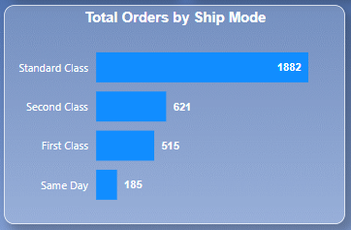
Shipping Analysis
Here is an small Break down between Our Shipping Modes.
We can see most of our customer prefer Standard class shipping.
Here is an small breakdown (total order we got is 3203)
Standard Class: 58.76%(1882)
Second Class: 19.39%(621)
First Class: 16.08%(515)
Same Day: 5.78%(185)
There could be several reasons for customers to choose the shipping mode.

Slide 28
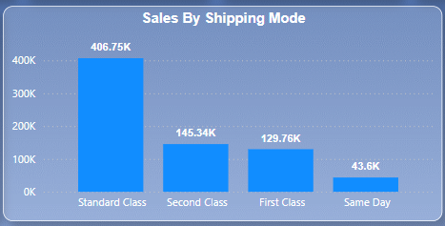
Shipping Analysis
Here is an small Break down of sales By Shipping Modes.
We can see most of our sales came form Standard class shipping (406.75K)
Here is an small breakdown (Total sales 725.46K)
Standard Class: 56.06%(406.75K)
Second Class: 20.01% (145.34K)
First Class: 17.88% (129.76K)
Same Day: 6.05% (43.6K)
There could be several reasons for customers to choose the shipping mode.

Slide 29
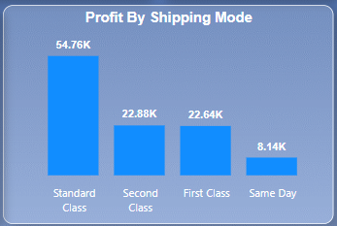
Shipping Analysis
Here is an small Break down of Profit By Shipping Modes.
We can see most of our sales came form Standard class shipping (108.42K)
Here is an small breakdown (Total Profit 108.24K)
Standard Class: 50.63%(54.76K)
Second Class: 21.12%(22.88K)
First Class: 20.92%(22.64K)
Same Day: 7.53%(8.14K)
There could be several reasons for customers to choose the shipping mode.

Slide 30
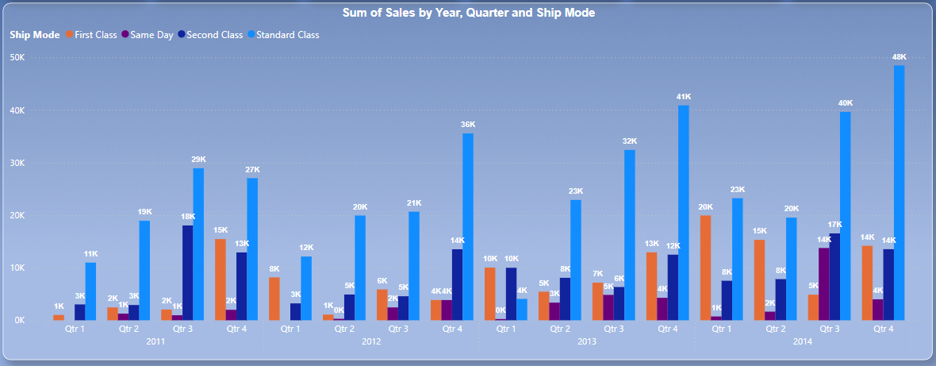
Shipping Analysis
Here is an Break down of shipping mode through of 2011 to 2014 in quarter.
Here we can see during the Q1 Customers are not preferring same day delivery.
There could be several reasons for customers to choose the shipping mode.

Slide 31
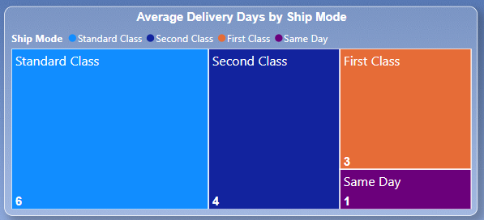
Shipping Analysis
Here is an small Break down of Average delivery days by shipping modes.
We can see the standard class shipping is most used by customers and it is take on an average of 6 days to deliver
Here is an small breakdown
Standard Class: 6 Days
Second Class: 4 Days
First Class: 3 Days
Same Day: 1 Day
Since most people are using Standard class shipping it is advised to bring down the average shipping days to 5
As a test Setting multiple state hubs on our top selling states can help us Achieve that

Slide 32
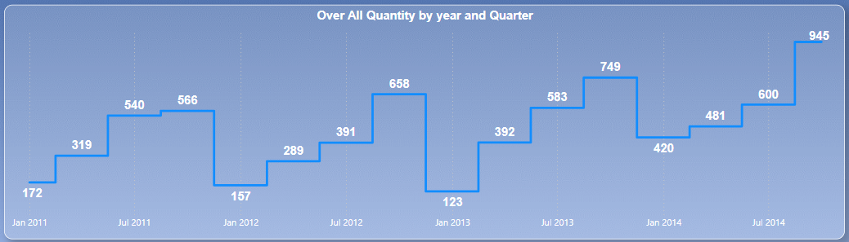
Quantity/Inventory Analysis
If you take a closer look we are selling more quantities in Q4 Compared to Q1,Q2 and Q3
So maintaining inventory is important and much more concentration are need During Q4’s
Finding the fast selling products during each Quarter will be an added advantage.
The quantity sold bump in Q4 is not shocking because from previous charts we know are getting more orders During Q4

Slide 33
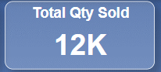
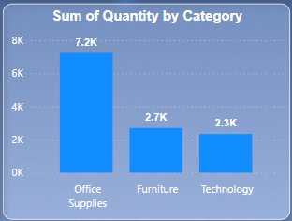
Quantity/Inventory Analysis
Approximately 12k units were sold in sales.
Office supplies category recorded the highest sales quantity, accounting for 60% (7.2K) of the total.
The breakdown of total quantity sold:
Office supplies: 60% (7.2K)
Furniture: 22.5% (2.7K)
Technology: 19.17% (2.3K)
Considering that most orders could be in bulk in the office supplies category.

Slide 34
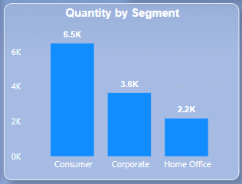
Quantity/Inventory Analysis
Approximately 12k units were sold in sales.
Consumer segment recorded the highest sales quantity, accounting for 54.1% (6.5K) of the total.
The breakdown of total quantity sold:
Consumers : 54.17% (7.2K)
Corporate: 30% (2.7K)
Home Office: 18.33% (2.3K)

Slide 35
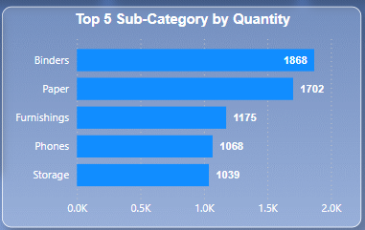
Quantity/Inventory Analysis
Approximately 12k units were sold in sales.
Binders recorded the highest sales quantity, accounting for 15.57% (1868) of the total.
The breakdown of total quantity sold:
Binders : 15.57% (1868)
Paper: 14.18% (1702)
Furnishings: 9.79% (1175)
Phones: 8.9%(1068)
Storages: 8.66%(1039)

Slide 36
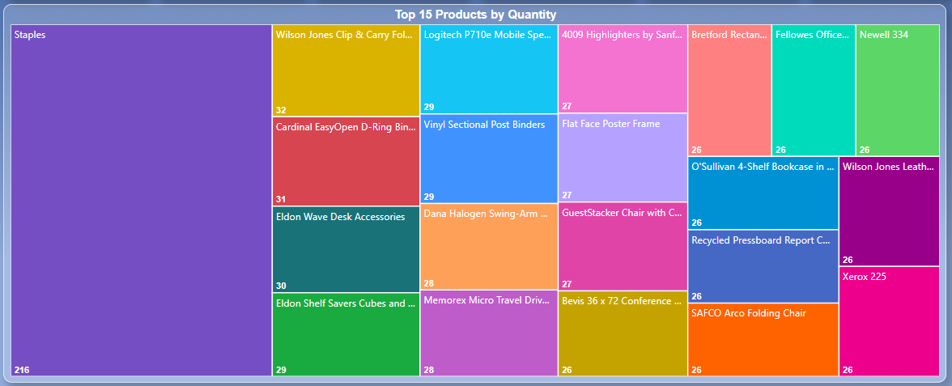
Quantity/Inventory Analysis
The above-mentioned chart illustrates the top 15 selling products throughout the years from 2011 to 2014.
Maintaining a good volume of inventory is recommended for these products (solely based on sales quantity), ensuring availability to meet customer demand.
It is advisable to examine seasonal trends to make more informed decisions.

Slide 37
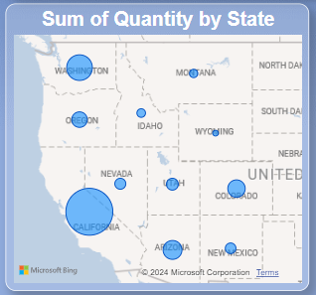
Quantity/Inventory Analysis
The chart provides a breakdown of states by quantity sold, with the size of each circle indicating the quantity sold.
Here is a summary:
California: 63.89% (7667 Qty)
Washington: 15.69% (1883 Qty)
Arizona: 7.18% (862 Qty)
Colorado: 5.78% (693 Qty)
Oregon: 4.16% (499 Qty)

Slide 38
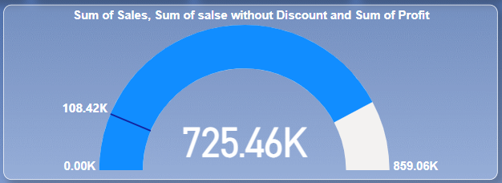
Revenue Analysis
Profit
Total sales
Total sales without Discount
Revenue overview from 2011 to 2014.
The total sales without discounts amounted to 859.06K
while the total sales after discounts stood at 725.46K.
The profit generated was 108.42K.
We will see how much we lost on discount in the upcoming slides

Slide 39
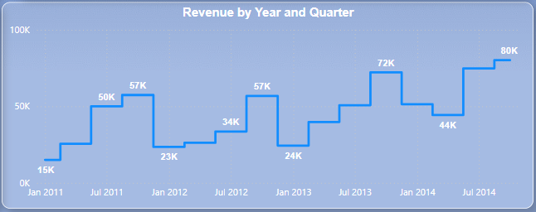
Revenue Analysis
Revenue overview from 2011 to 2014:
Our revenues increase every year during Q4 compared to Q1, Q2, and Q3.
The highest revenue we made was during Q4 of 2014 (80K).

Slide 40
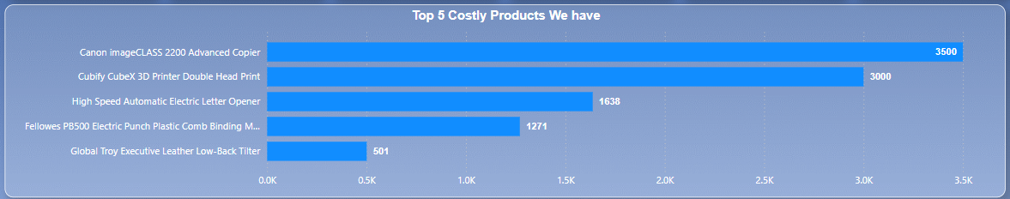
Product Cost Analysis
After calculating product prices, I identified the top high-ticket products we sell:
Canon image CLASS 2200 Advanced Copier - 3500
Cubify CubeX 3D Printer Double Head Print - 3000
High Speed Automatic Electric Letter Opener - 1638
Fellowes PB500 Electric Punch Plastic Comb Binding Machine -1271
Global Troy Executive Leather Low-Back Tilter - 501

Slide 41
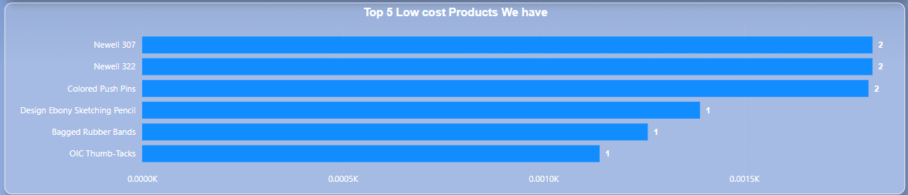
Product Cost Analysis
After calculating product prices, I identified the top Low-ticket products we sell:
Newell 307 - 2
Newell 322 -2
Colored Push Pins -2
Design Ebony Sketching Pencil - 1
Bagged Rubber Bands - 1
OIC Thumb-Tacks - 1

Slide 42
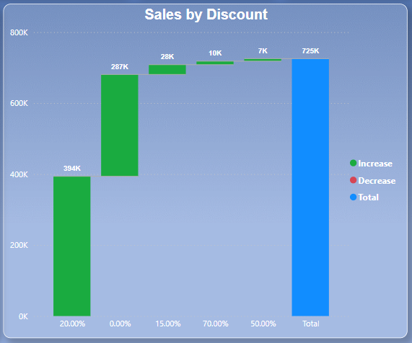
Discount Analysis
This chart illustrates sales by discounts.
The discount of 20% yielded the highest sales, totaling 394K.
The maximum discount of 70% resulted in sales of 10K.
The least sales were driven by the 50% discount, with 7K in sales.

Slide 43

Discount Analysis
The chart displays Profit by discounts.
The 20% discount resulted in the highest Profit after discounting, totaling 77K.
Conversely, the 70% discount incurred a substantial loss of -12K.
Similarly, the 50% discount also resulted in a loss of -4K.
It is advisable to consider these figures while making discounting decisions.

Slide 44

Quantity Analysis
Quantity breakdown by discount reveals:
70% discount was applied to various quantities:
1 qty: 6 orders
2 qty: 25 orders
3 qty: 15 orders
4 qty: 10 orders
5 qty: 11 orders
6 qty: 11 orders
7 qty: 14 orders
8 qty: 4 orders
9 qty: 1 order
10 qty: 2 orders
14 qty: 1 order

Slide 45

Quantity Analysis
Profit breakdown by discount reveals:
We made -11,709.05 in loss by giving 70% discount
70% discount was applied to various quantities and loss it made:
1 qty: 6 orders (-217.88)
2 qty: 25 orders (-1086.92)
3 qty: 15 orders (-690.05)
4 qty: 10 orders (-290.15)
5 qty: 11 orders (-479.34)
6 qty: 11 orders(-2599.64)
7 qty: 14 orders (-148.93)
8 qty: 4 orders (-413.71)
9 qty: 1 order (-59.06)
10 qty: 2 orders (-48.77)
14 qty: 1 order (-25.59)

Slide 46
Pareto Analysis (80:20 Rules)
The Pareto Principle is based on the Presumption that a relatively small number of inputs (20%) have most impact on the results/output (80%).

Slide 47
Our Approach
Using pareto Analysis We analyze the following to get a better clarity
State,
Customer,
Sub-Category.

Slide 48

In the chart above, we can clearly see that California is the highest contributor in sales.
Therefore, it is recommended to allocate considerable resources to California.
Additionally, it is recommended to apply the Five Whys technique to understand underlying issues.
Gather customer feedback for better improvement.

Slide 49

In the chart above, we can see a Huge number of customers Who are contributor the highest in sales.
We can try contacting a few of the customers and collecting feedback for better improvement
And it is advised to give coupons for the customers who would like to give feedback.
Following these Steps we can Find Fix a few Issues.

Slide 50

In the chart above, we can see that Chairs, Phones, Tablets, storages, accessories, Binders, Copiers and machine contributor in sales.
Therefore, it is recommended to allocate considerable resources to California.
Additionally, it is recommended to apply the Five Whys technique to understand underlying issues.
Gather customer feedback for better improvement.

Slide 51
Thank You
By
G. Arivazhagan
MBT7

